Slide 1
Impactful Data Science
The new BSSS Data Science Course
Notes:
About me

Slide 2

What is this talk about?
Data Science - what is it about?
What is in the new BSSS Data Science Course?
Can I teach this course?
Teaching and learning resources
Hand's on exercises
Notes:
Data Science has applications across the sciences, humanities, computer science and mathematics. The skills and knowledge presented are critical for 21st century learners and future careers. This seminar introduces teachers to knowledge, skills, resources and learning plans necessary for teaching Data Science in 2020, with a specific focus on the units of study: Data Representation and Analysis, and Big Data Analysis and Techniques. Teachers will be given hands-on experience with the tools and resources required for teaching Data Science, as well as roadmaps for improving their skills. Data science, especially in the areas of Big Data and Machine Learning, is already having an enormous impact upon our society. As machine learning goes to scale, the implications for our future world is immense. Students who engage with this area of study will have the chance to shape the impacts of these changes.

Slide 3
To follow along (own device)
In order to follow along:
You need a device - preferably something with a decent screen size
You need a browser - you will need to access Google Drive
You need access to Drive and Github - the resources are shared by link
http://colab.research.google.com
http://bit.ly/2O5P1F6 ⇐ This Presentation

Slide 4

What is Data?
Notes:
William the conqueror won the battle of hastings in 1066 killing Harold. in 1085 he ordered a survey of the kingdom to ensure correct taxation of his subjects.
The survey also established land ownershiop and boundaries.
The word data comes as the plural of datum - the past participle of dare - to give.
The English word "date" has the same origin. A recorded entry was "given" on a particular date.
Like the captains log in Star trek.
Data has a history!
Data is a mapping of information. A reductive view of the entire world/universe into discrete and manageable parts.
As a result: data is always partial: it is never a complete mapping of the world (with a few exceptions I may cover later if reminded)
Data is contextual: it makes sense in context: taken out of context the meaning may be distorted.
Data is structurally biased.
Data is often incomplete - a sample only of parts of the world

Slide 5
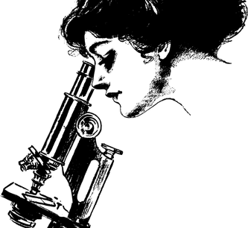
What is Data Science?
Where is the science?
Doesn't science use data?
What makes this a field?
Notes:
We'll look at a few definitions

Slide 6
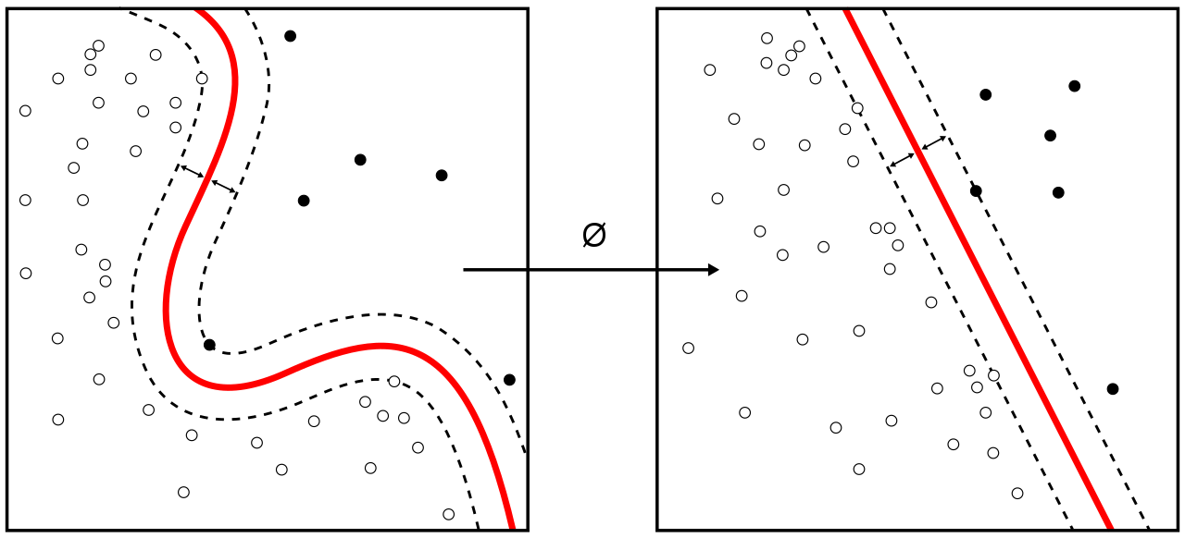
Wikipedia
Data science is a inter-disciplinary field that uses scientific methods, processes, algorithms and systems to extract knowledge and insights from structured and unstructured data.
Notes:
A good place to start - and for us to challenge the definition given.

Slide 7
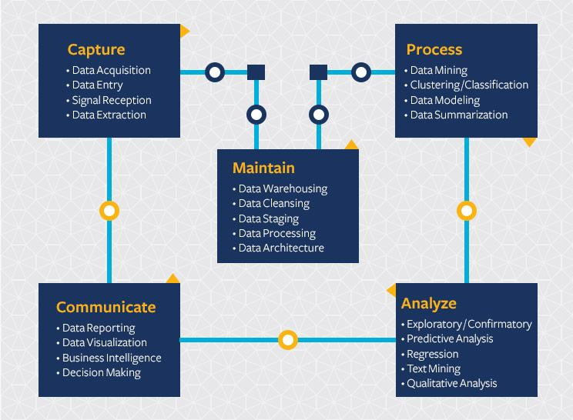
University of Berkeley
"Data science continues to evolve as one of the most promising and in-demand career paths for skilled professionals. Today, successful data professionals understand that they must advance past the traditional skills of analyzing large amounts of data, data mining, and programming skills. In order to uncover useful intelligence for their organizations, data scientists must master the full spectrum of the data science life cycle and possess a level of flexibility and understanding to maximize returns at each phase of the process."
Notes:
Academia may supply a more rigorous definition
But in this case - it is weighted towards the utilitarian, being classified as a career path

Slide 8

Oracle
Data science is an interdisciplinary field that uses scientific methods, processes, algorithms, and systems to extract value from data. Data scientists combine a range of skills—including statistics, computer science, and business knowledge—to analyze data collected from the web, smartphones, customers, sensors, and other sources.
Data science reveals trends and produces insights that businesses can use to make better decisions and create more innovative products and services. Data is the bedrock of innovation, but its value comes from the information data scientists can glean from it and then act upon.
Notes:
OIracel (very similar to Wikipedia - who is plagiarising whom?) - looks at the utility of data science in terms of business applications.

Slide 9
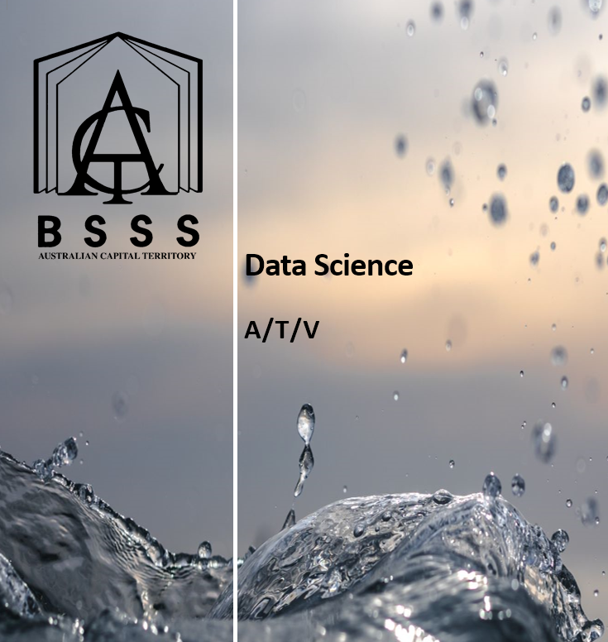
What is in the new BSSS course in Data Science?
and how does this relate to other courses?
Notes:
What is in the BSSS course?

Slide 10
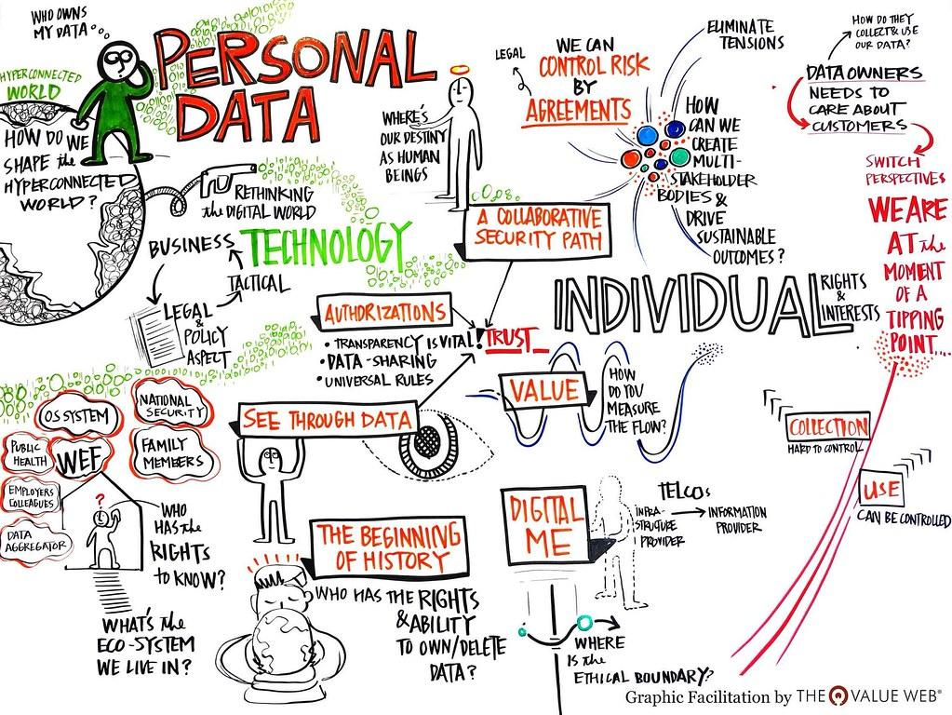
Data Representation and Analysis
Notes:
This unit explores the ways that digital information is encoded, represented, manipulated, stored, compressed and transmitted. Understanding where data comes from, having intuitions about what could be learned or extracted from it, being able to use computational tools to digitally manipulate data, visualise it and identifying patterns, trends, and to use data to develop narratives and arguments are the primary skills addressed in the unit.

Slide 11
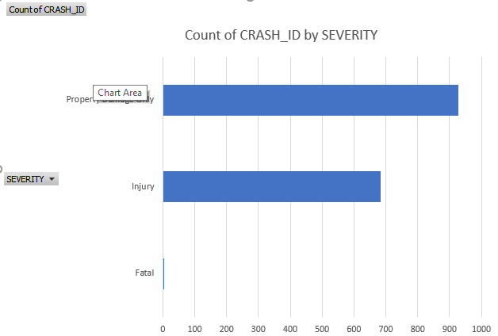
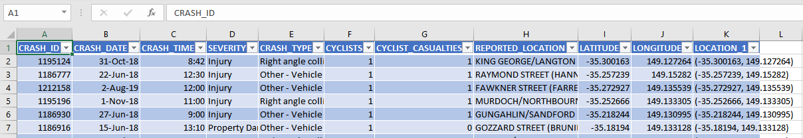
From this
Source: ACT Open Data Portal

Slide 12
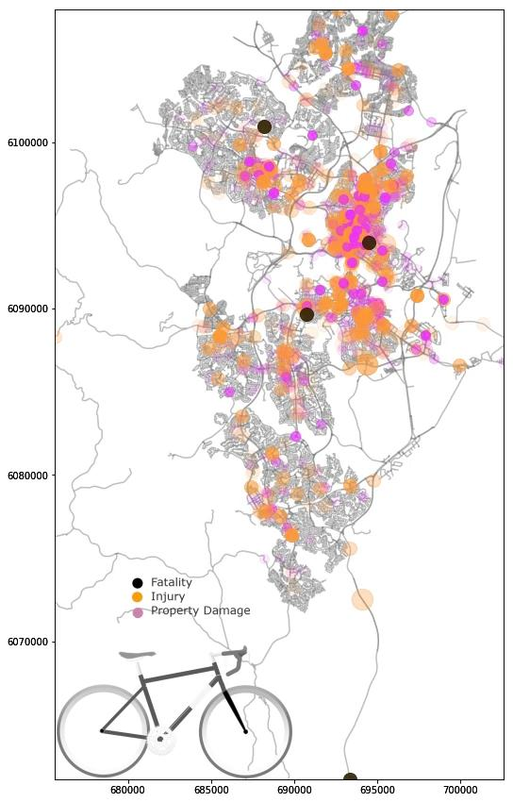
To This
Or even this: https://guns.periscopic.com/
https://www.informationisbeautifulawards.com/showcase/3978

Slide 13
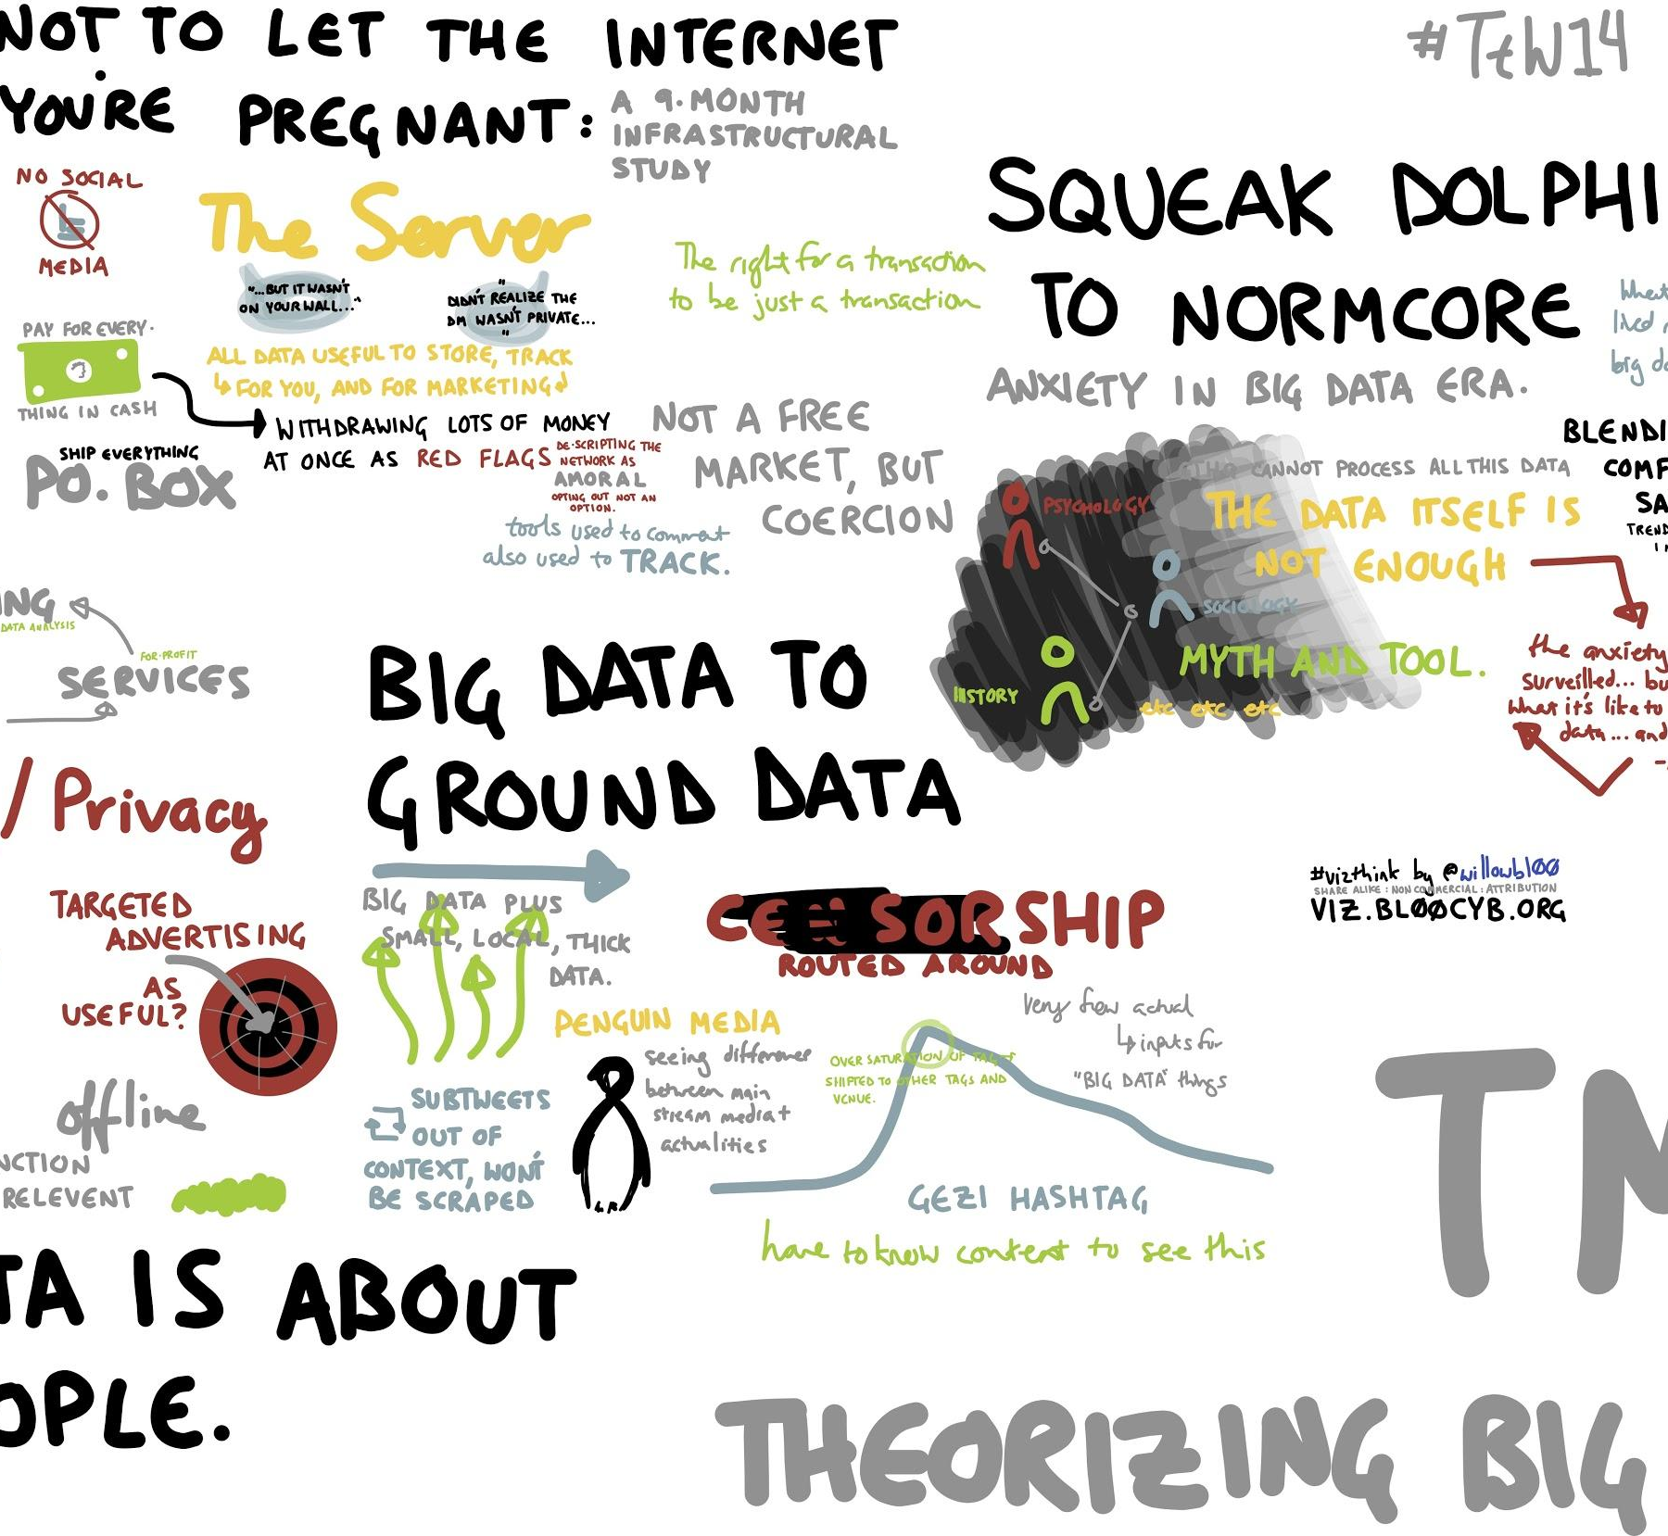
Big Data Analysis & Techniques
Volume
Velocity
Variety
Veracity
Notes:
The data-rich world that we live in introduces many complex questions related to public policy, law, ethics and social impact. The goals of this unit are to develop a well-rounded and balanced view about data in the world, including the positive and negative effects of it. Students develop skills in using data analysis processes, relevant algorithms and techniques and computational tools to analyse Big Data using a multidisciplinary approach.

Slide 14
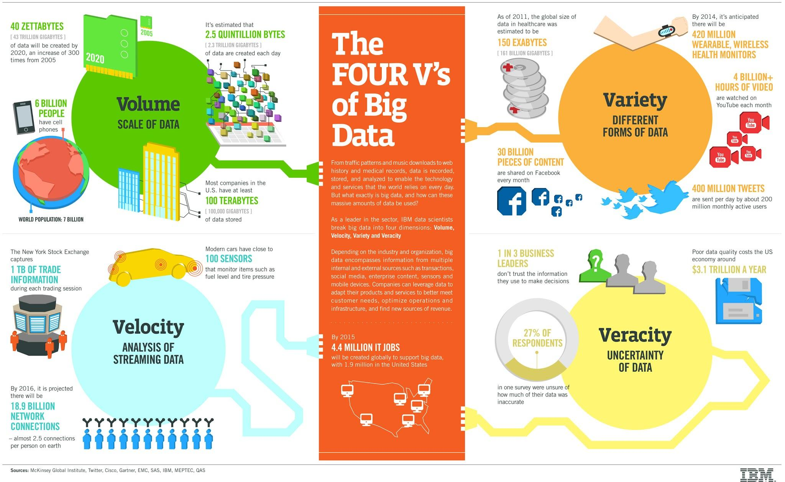

Slide 15
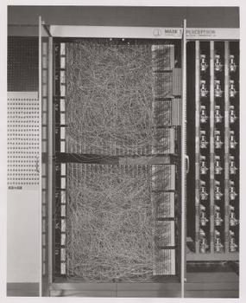
Machine Learning
A programmed system which identifies patterns in data and adapts a model to these patterns to identify/classify new data elements or predict future data trajectories.
Notes:
This unit explores how Machine Learning is used to develop models for prediction, analysis, diagnosis and recommendation. Students develop an understanding of Machine Learning, and the algorithms, techniques and processes used in supervised and unsupervised models. They use Machine Learning to analyse authentic datasets from a range of sources, and investigate the inherent bias in training data. They build models or applications which enable predictions or recommendations, contextualising the social impact of their Machine Learning application.

Slide 16
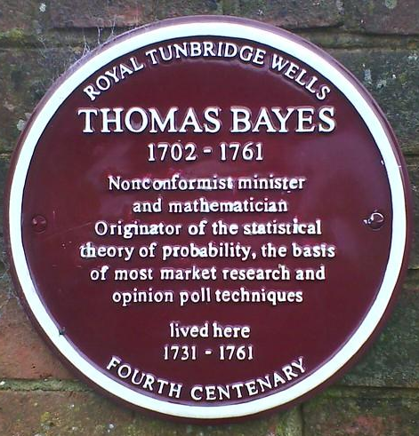

ML History
1763 - Thomas Bayes
1943 - Pitts and McCulloch - electrical circuit model of neuron
1950 - Turing - Idea for a machine that learns
1951 - first neural network (Minsky/Edmonds)
1952 - Arthur Samuels names "ML". An algorithm that learns to play checkers
1957 - Rosenblatt - Perceptron

Slide 17
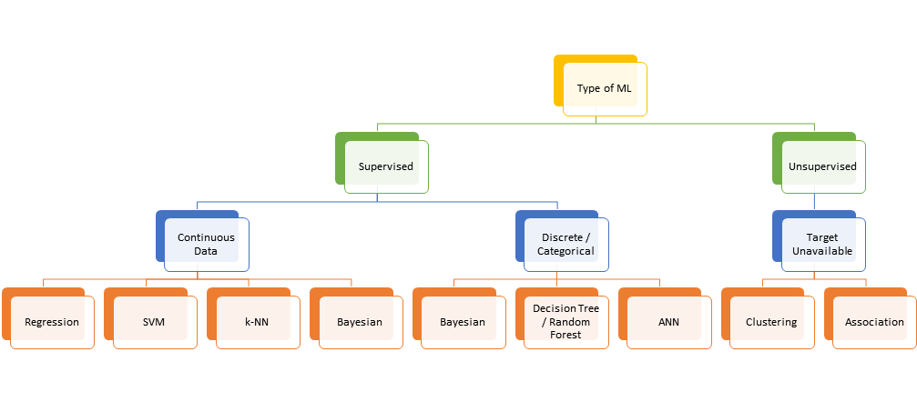
Main types of ML
Regression
Nearest Neighbour
Bayesian Models
Support Vector Machines
Artificial Neural Networks

Slide 18



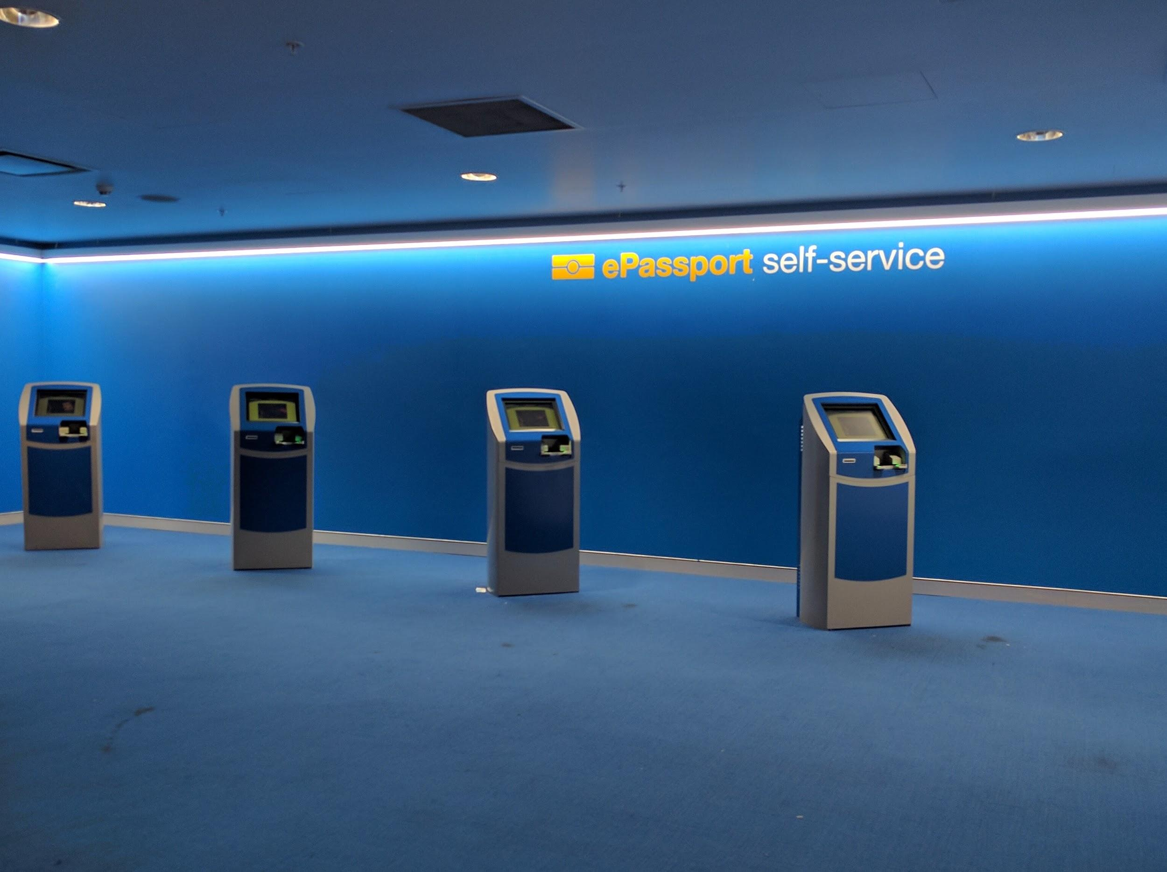
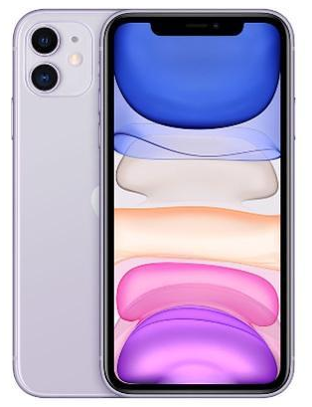


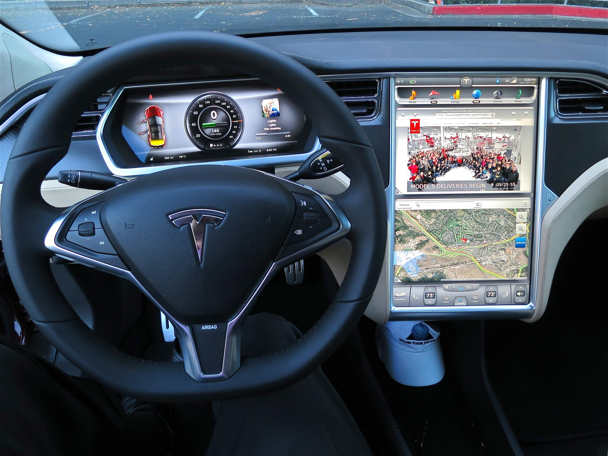

ML in our lives
ML is also used in Healthcare, Education, Scientific Research, Economics, and even Taxation.

Slide 19
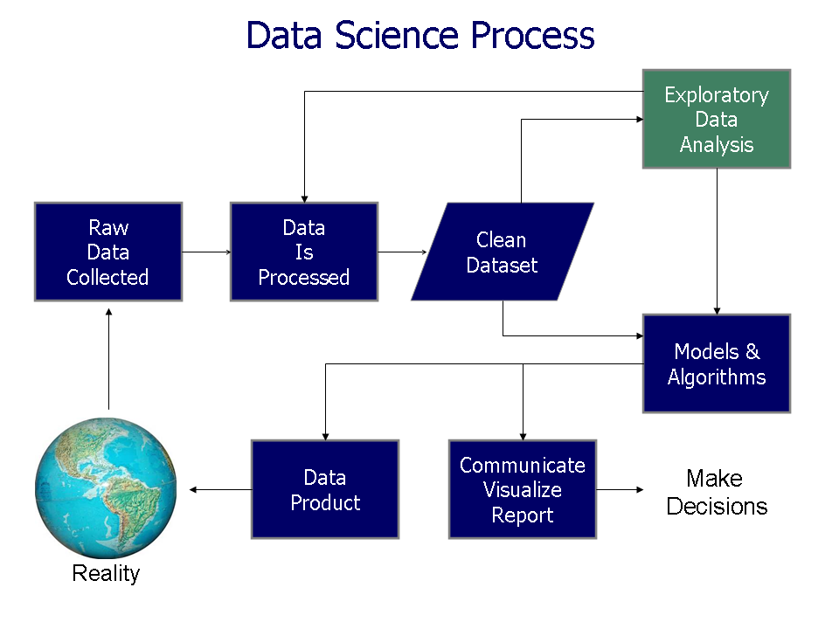
Data Research Project
Using techniques learned in the other units, students work on their own project to develop a hypothesis, collect data, process the data, analyse the data and make predictions using that data.
They may incorporate data science techniques into a range of applications/systems.
Notes:
This unit enables students to undertake their own research project to develop and test hypotheses using real-world data sets. They further develop their data analysis skills, and explore patterns in data that yield interesting results. Students present conclusions drawn from their analysis, and communicate their findings through visualisations and arguments that inform and maximise impact.

Slide 20
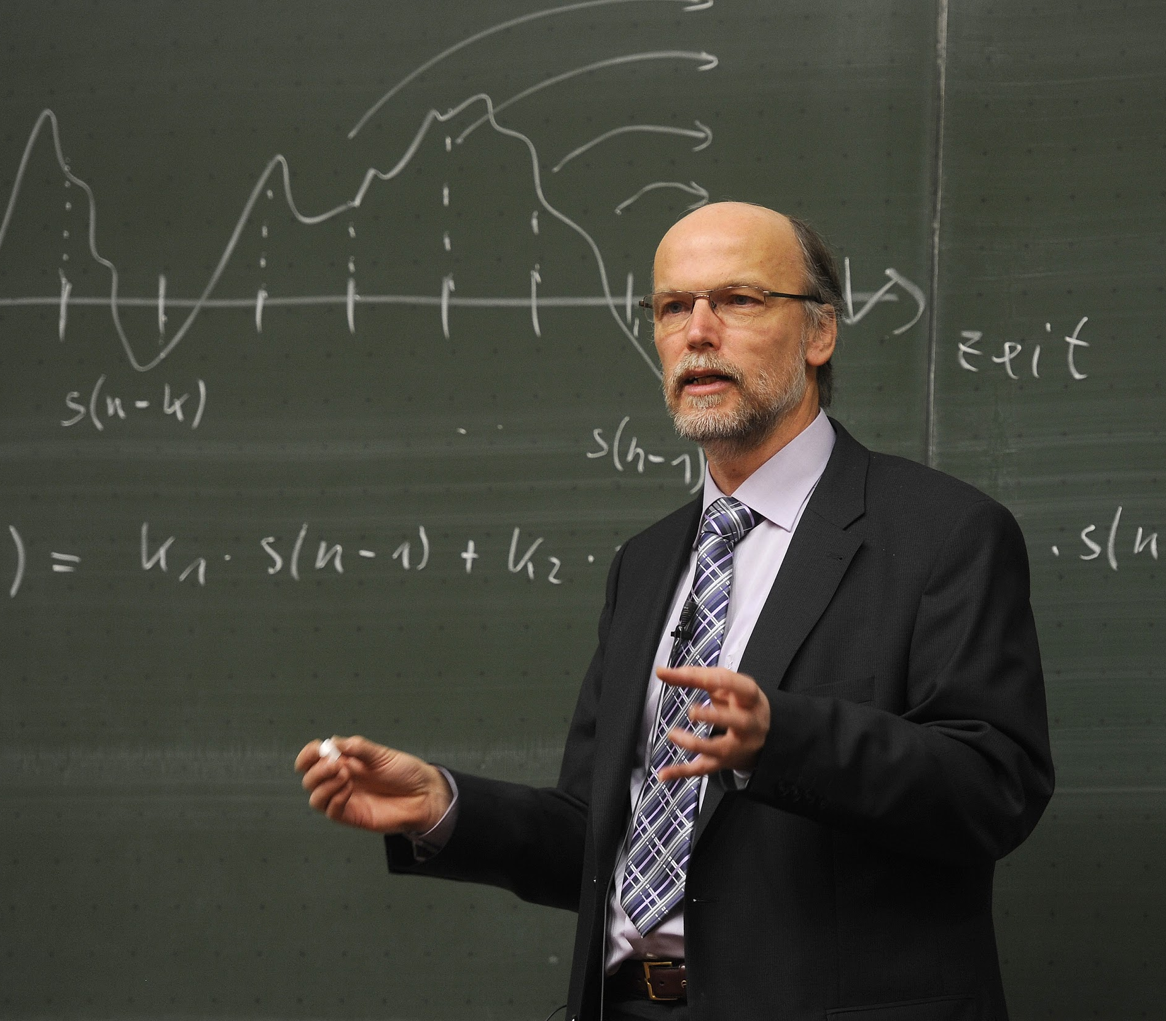
Can I teach this course?
Required knowledge
Mathematics
Basic Statistics (we will help you through the extra bits)
Spreadsheets
Programming
Maths, Science, Technology and many other teacher specialisations can teach this
We will help!

Slide 21

Can I teach this course?
Required knowledge
Mathematics
Basic Statistics (we will help you through the extra bits)
Spreadsheets
Programming
Maths, Science, Technology and many other teacher specialisations can teach this
We will help!

Slide 22

Teaching and Learning Resources
Programs of Learning
Assignment Ideas
Lesson Ideas
Datasets / Data Capturing
Jupyter Notebooks

Slide 23
Hands-On Exercises
Using Jupyter Notebooks in Google Colab
http://bit.ly/315puBq
Data Analysis
http://bit.ly/313dG2p
Mapping
http://bit.ly/2RURbZk

Slide 24
Big Data
NCI Data
http://bit.ly/2t3lzrY
Google BigQuery
http://bit.ly/2tZbq00

Slide 25
Machine Learning
GPT2
http://bit.ly/2tbjLNQ

Slide 26
Shared Resources
Link to GitHub
http://bit.ly/2U7t10g

Slide 27
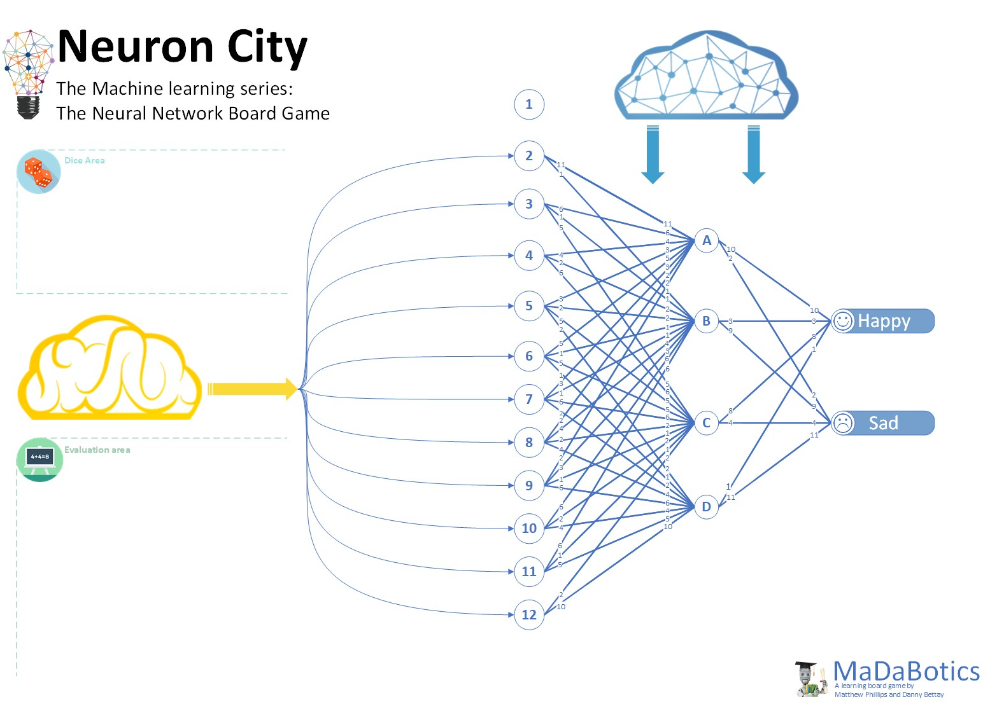
Neuron City
Resources available in GitHub

Slide 28
Contact
matthew.phillipps@ed.act.edu.au
matthew.phillipps@anu.edu.au

